Slide 1
CVPR 2021
Presentation by,
Shivanand Venkanna Sheshappanavar

Slide 2
Motivation

Slide 4
Modeling the Spatio-temporal structure in point cloud videos is extremely challenging
- coordinate sets are irregular and unordered
- points emerge inconsistently across different sets/frames
Approaches
convert a point cloud video into sequence of regular and ordered voxels
apply conventional grid-based convolutions to these voxels.
- computationally inefficient (e.g. Fast&Furious, MinkowskiNet)
2) directly model raw point cloud videos by grouping local points
point tracking is employed to preserve the temporal structure (e.g MeteorNet)
points may flow in and out across frames, accurately tracking points is extremely difficult
tracking error increases (in case of longer videos)

Slide 5
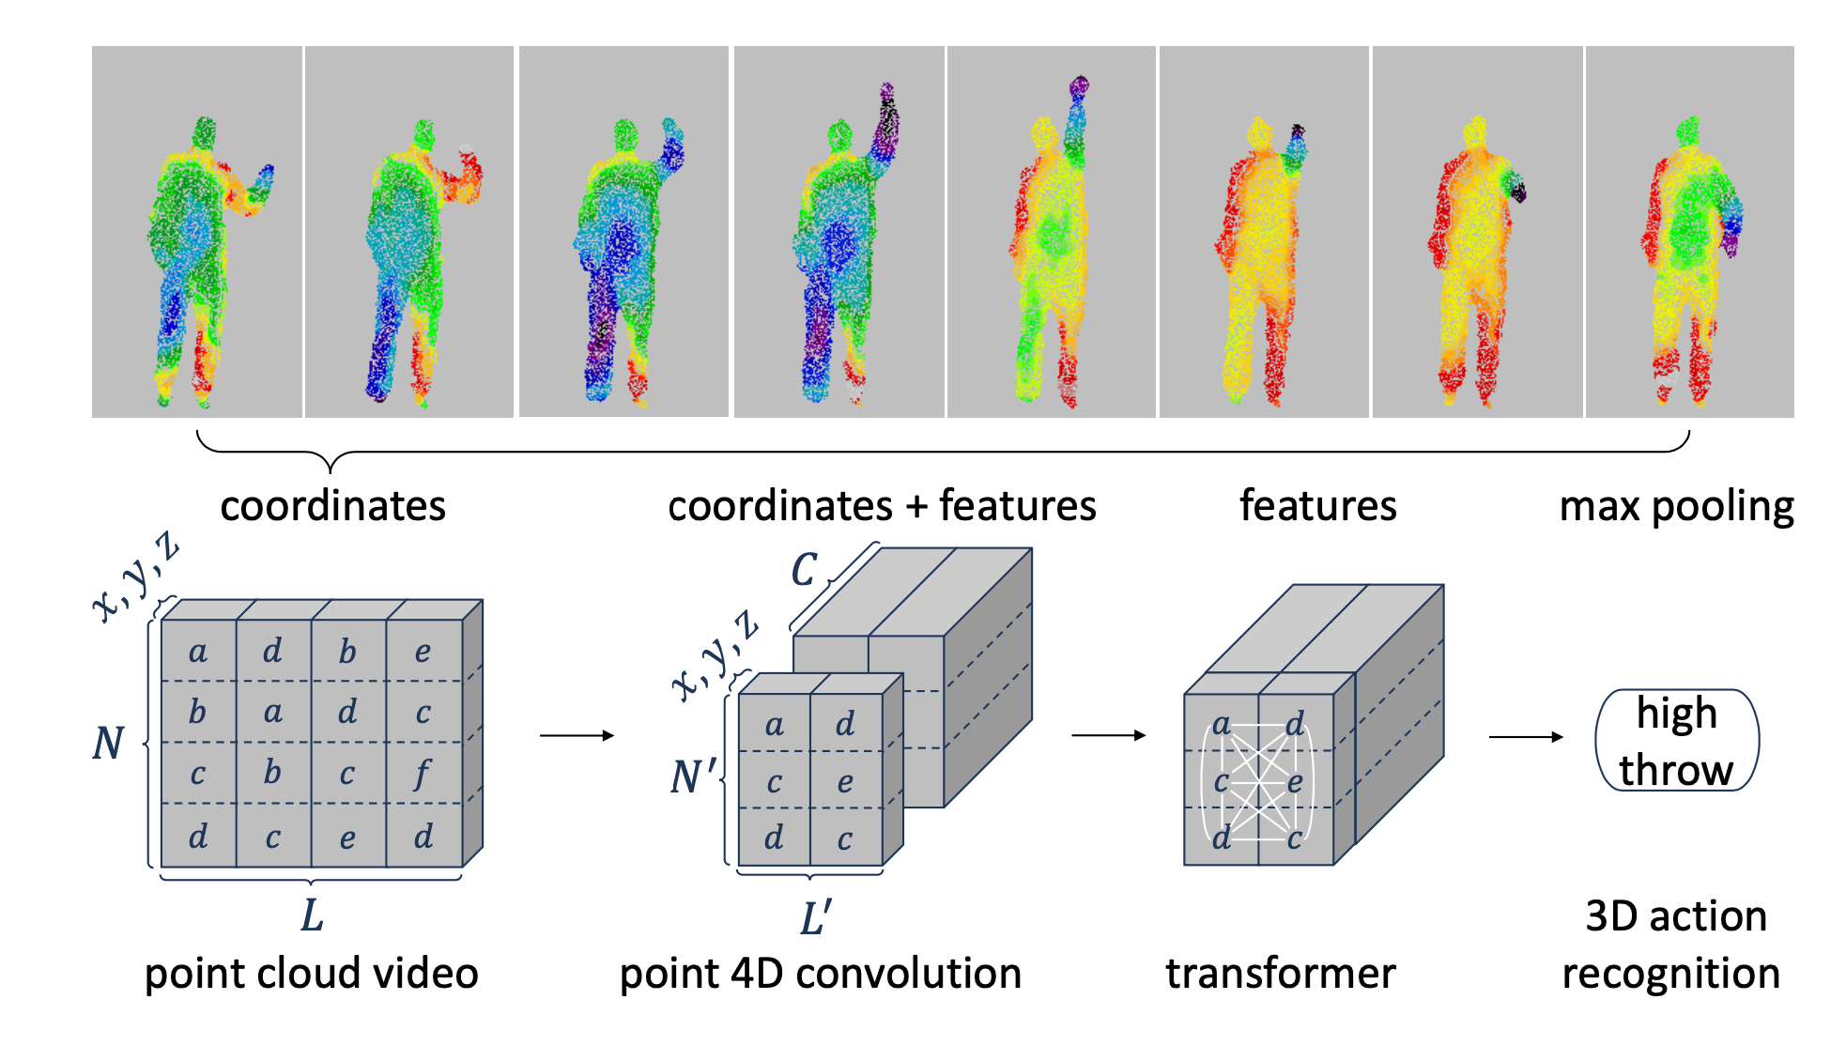

Slide 6
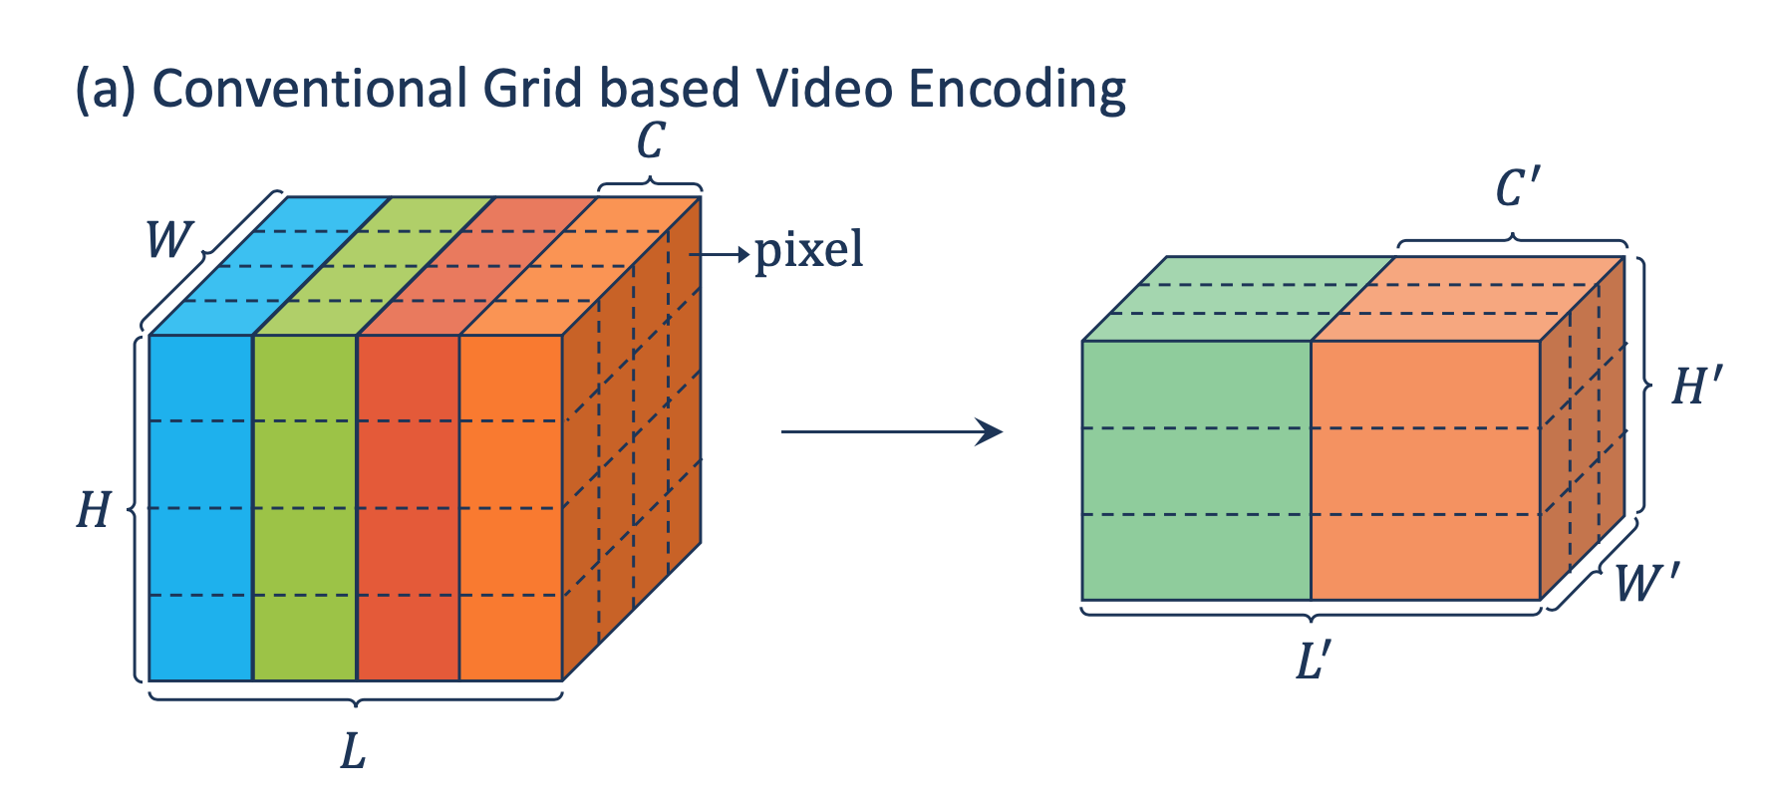

Slide 7
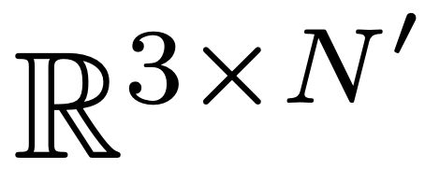
Point 4D Convolution
Point coordinates in t^{th} frame
N number of points
C is the number of channels
Point features in t^{th} frame
L is the number of frames

Slide 8
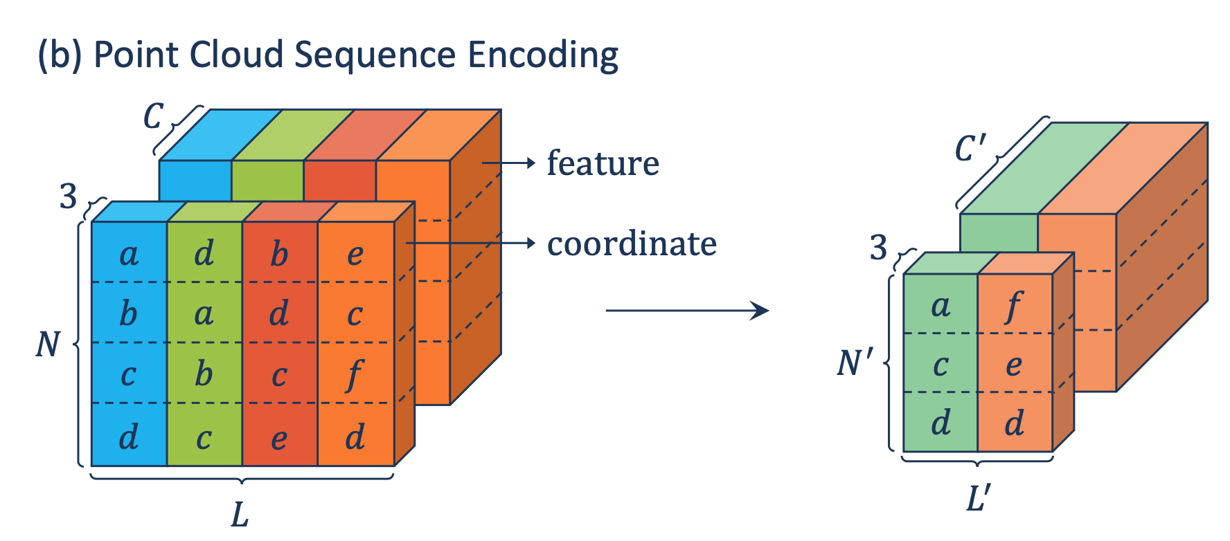

Slide 9
Point 4D Convolution
Sum
Avg
Max
spatial- temporal displacement
feature of point at position (x, y, z, t) in the point cloud video
G is the spatio-temporal local region around point (x, y, z, t).

Slide 11
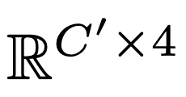
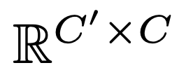

Slide 12
3D Action Recognition

Slide 13
Self-Attention
Perform Self-Attention on
Query Keys Values

Slide 14
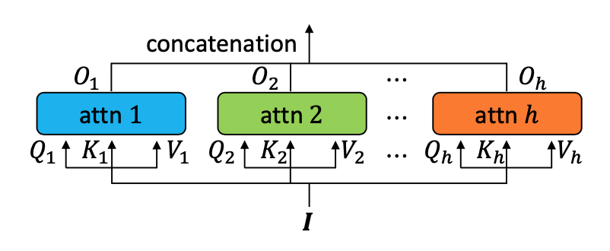
Video level Self-Attention vs. Frame level Self-Attention
softmax(all frames) softmax(individual frames)
Single-self Attention vs. multi-head Attention

Slide 15
Attention Visualization

Slide 17
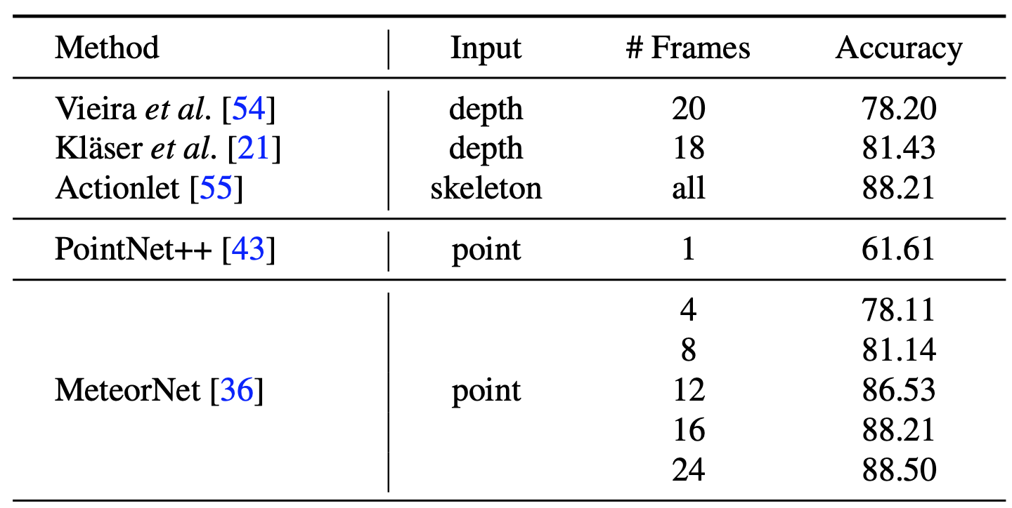
3D Action Recognition
MSR-Action3D
567 Kinect v1 depth videos
20 action categories
23K frames
Experiments conducted 10 times and mean is reported

Slide 18
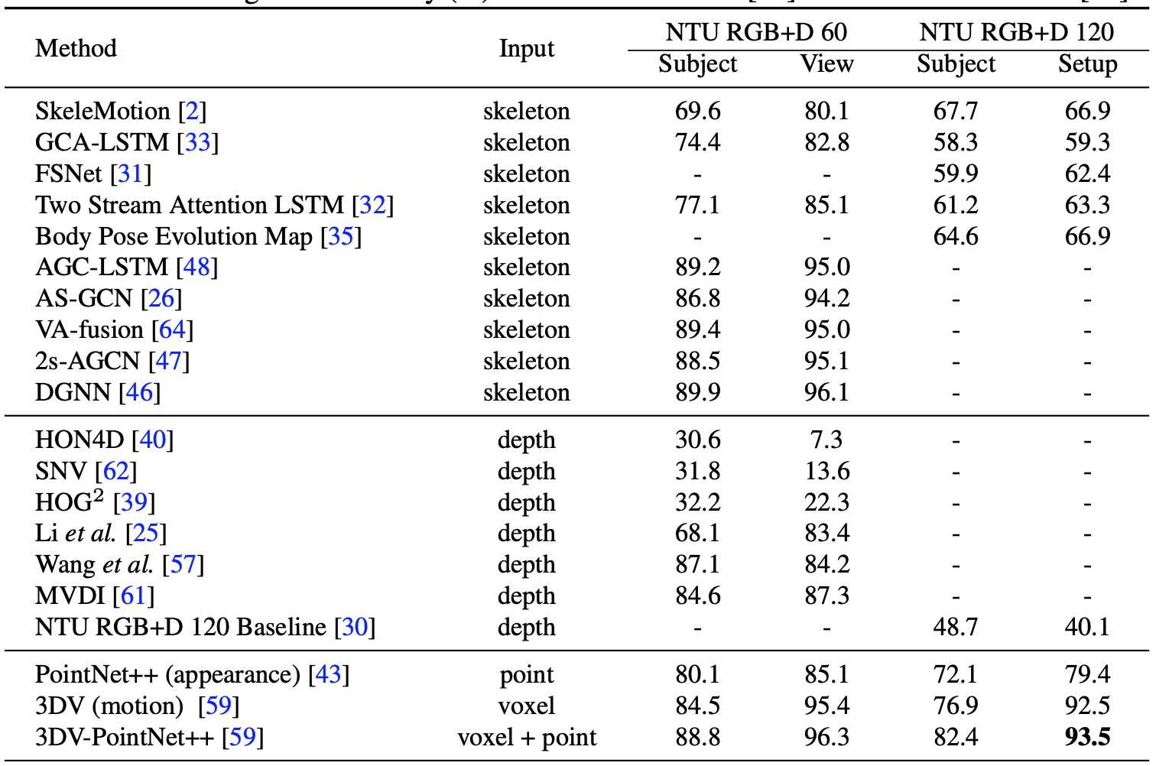
3D Action Recognition
NTU RGB+D 60
56K videos
60 action categories
4M frames
Kinect v2
3 cameras (cross-view)
40 subjects (cross-subject)
NTU RGB+D 120
114K videos
120 action categories
8M frames
Kinect v2
32 collection setups (loc, bg)
106 subjects

Slide 20
Synthia 4D ➔ 6 videos – driving
Training/validation/testing == 19,888/815/1,886

Slide 21
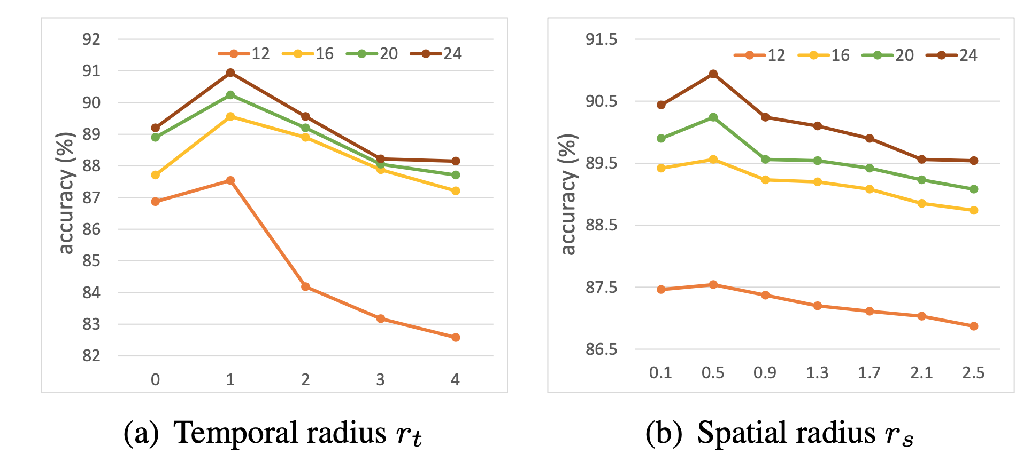
Ablation Study
Temporal Radius and Spatial Radius

Slide 22
Ablation Study
Temporal Radius and Spatial Radius

Slide 23
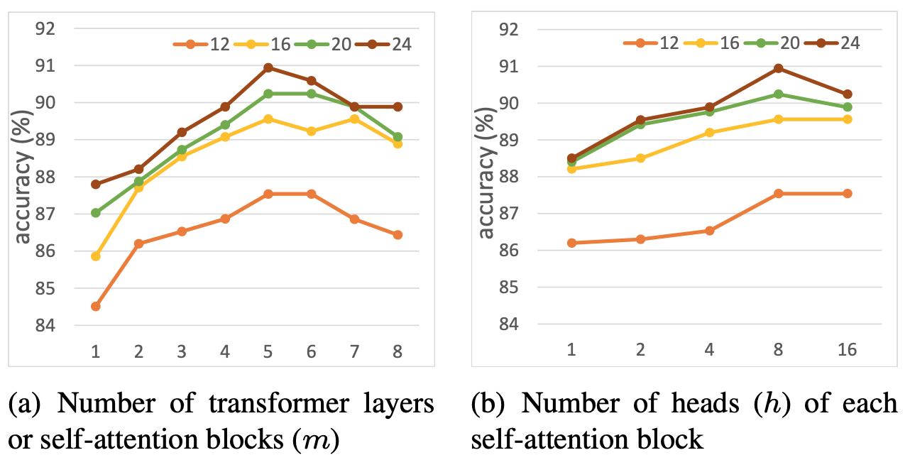
Ablation Study
Number of Transformers Number of Heads

Slide 24
Ablation Study
Video level Self-Attention vs. Frame level Self-Attention
softmax(all frames) softmax(individual frames)

Slide 25
Thank You

